Slide 1
K^{th} Order Approximation: Shifted Beam
May 26 2020
Shift expansion analysis (at waist,z=0):
Gaussian
0-100 micron offset tophat (34)
Computation times
Tophat ,varied max mode order

Slide 2
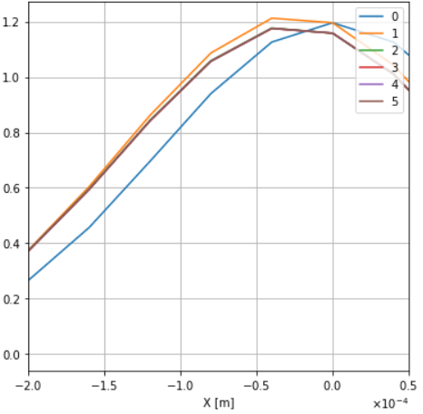
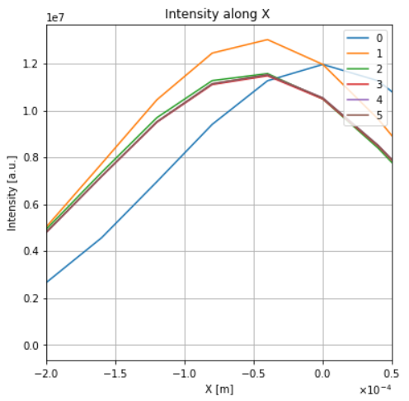
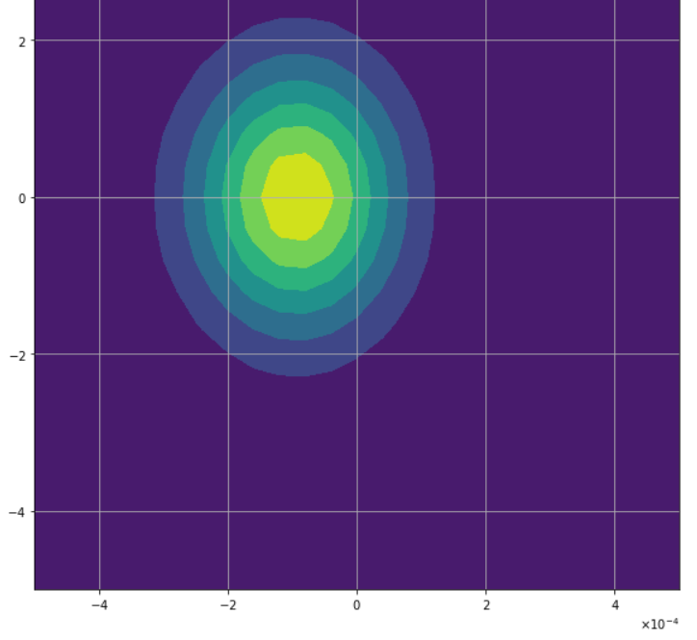
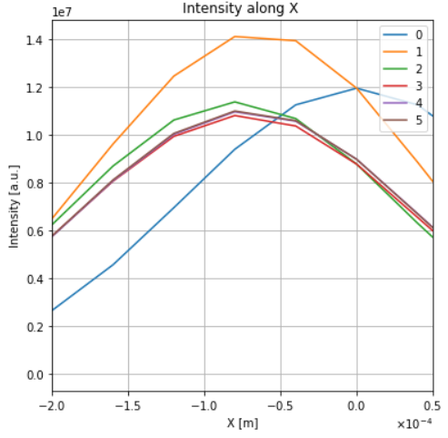
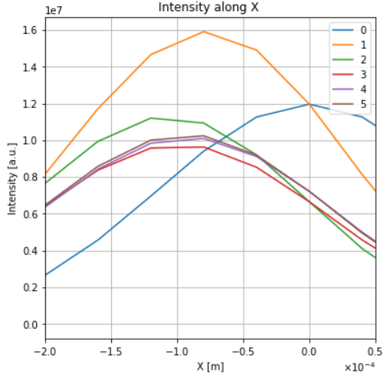
Shifted Gaussian
Intensity contour (100 micron) right
Intensity at y=0 below
Vertical lines show expected shift
(L to R: 25,50,75,100um)
Intensity (a=100um,5th order)
(image was low res)

Slide 3
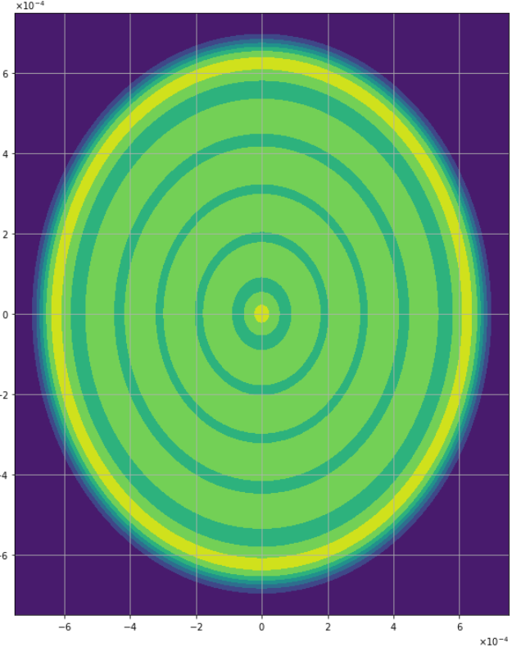
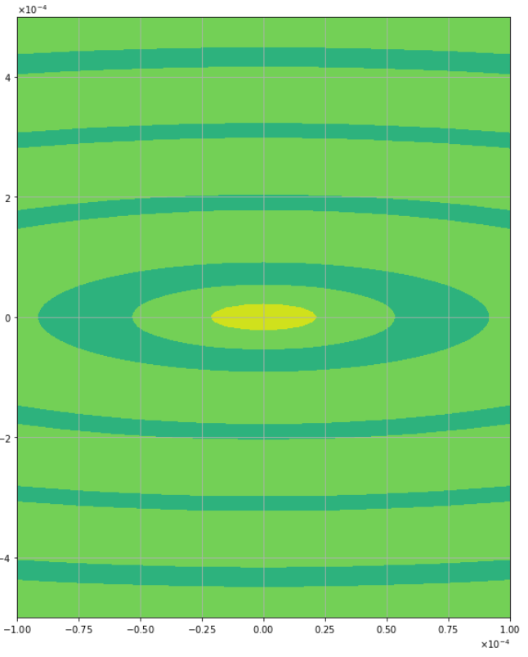
Shifted Tophat at Waist
Shifts for 25, 50, 75, 100 micron
Basis: beam radius = 2/3mm,w₀~ 0.2 mm
Full mode order 34
Intensity Resolution = 200x200
Full plot above zoomed plot
K = approximation order
Convergence results:
25um at K=2
50um at K=6
75 um at K=10?
100 um at K=14??

Slide 4
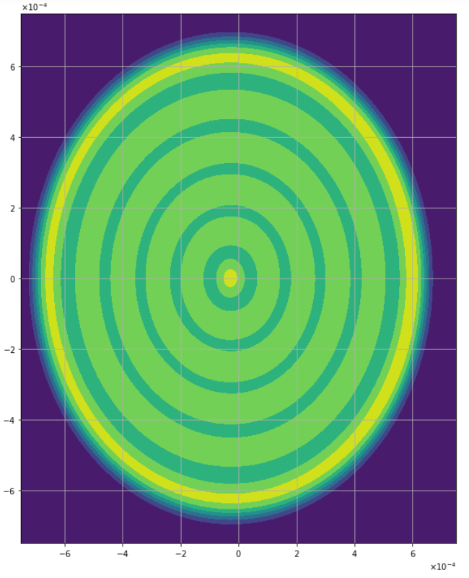
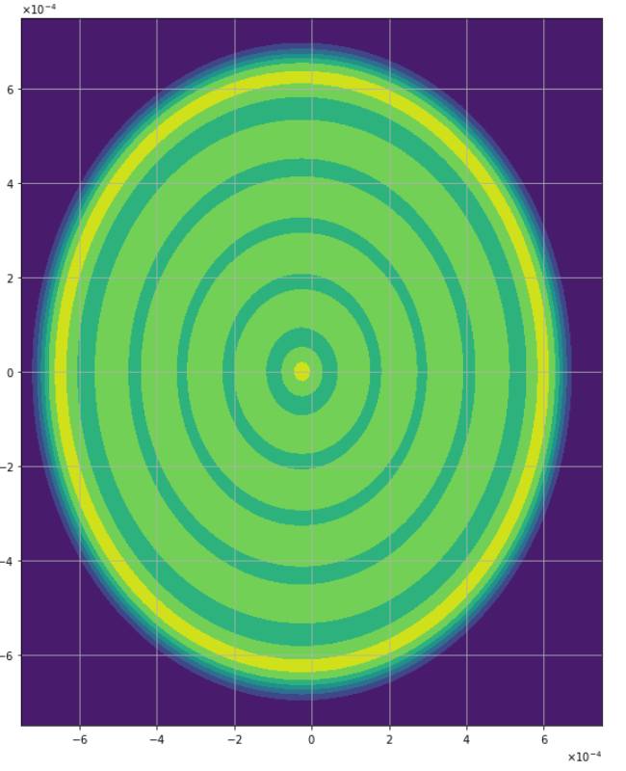
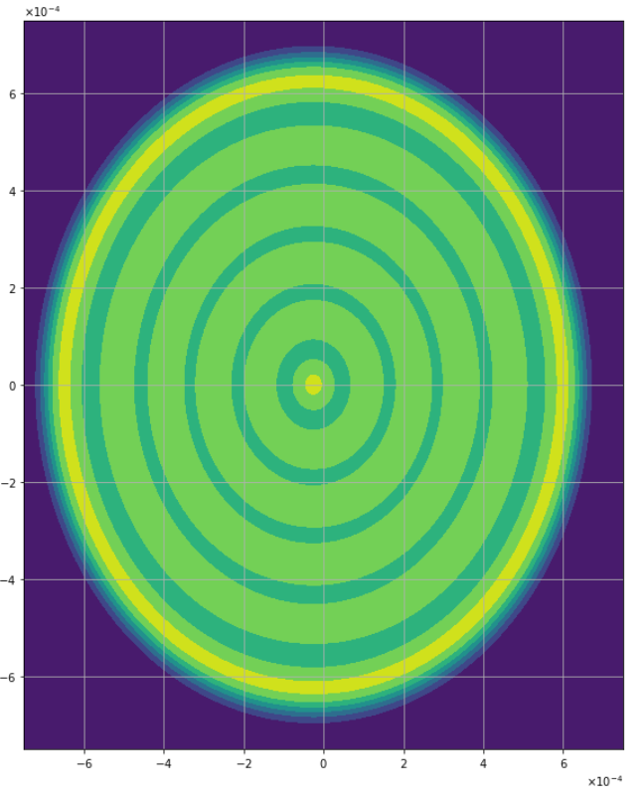
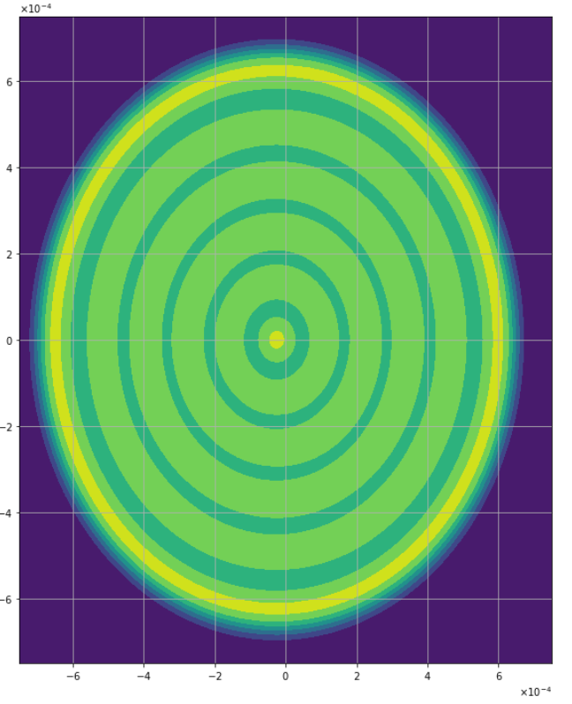
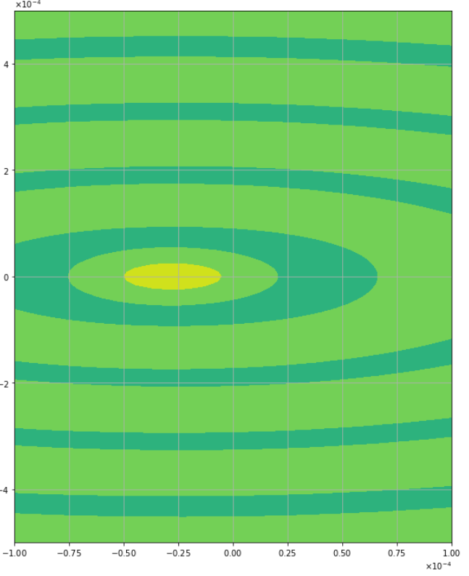
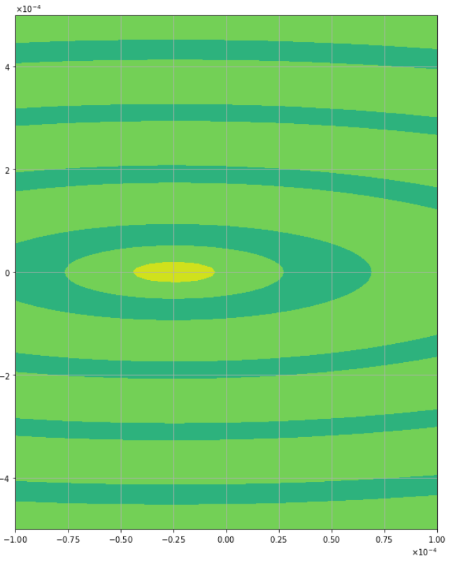
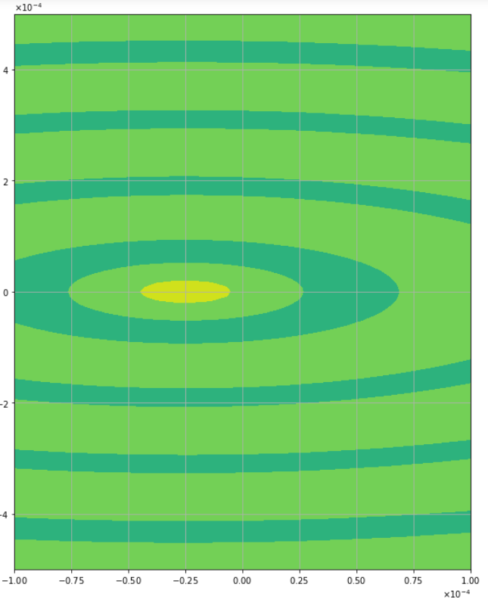

25 micron
K=2
K=4
K=6
K=8

Slide 5
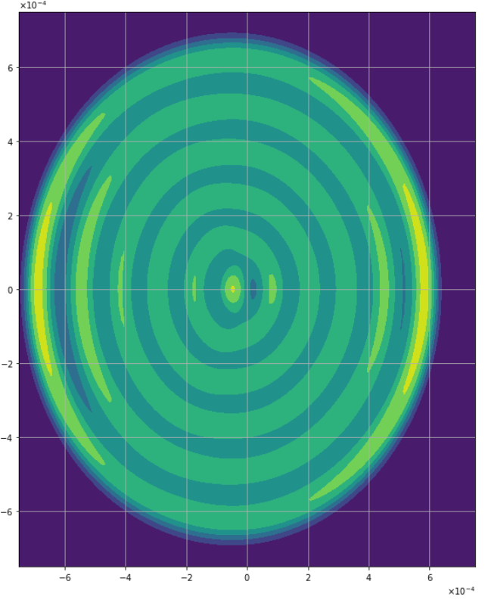
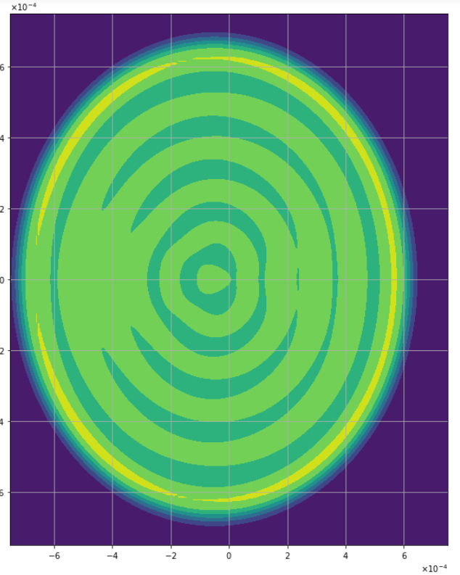
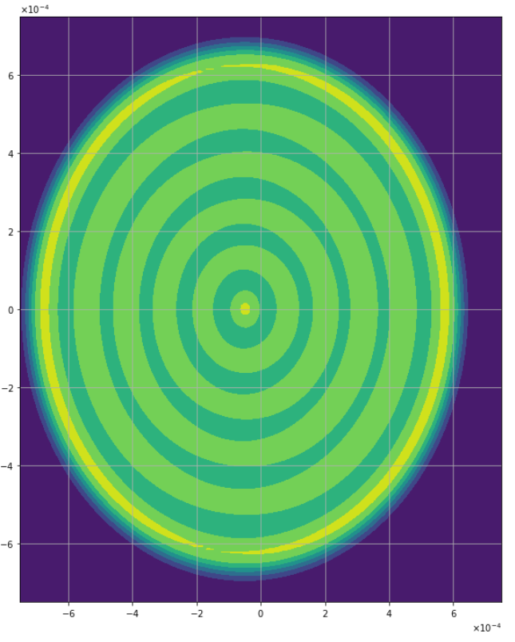

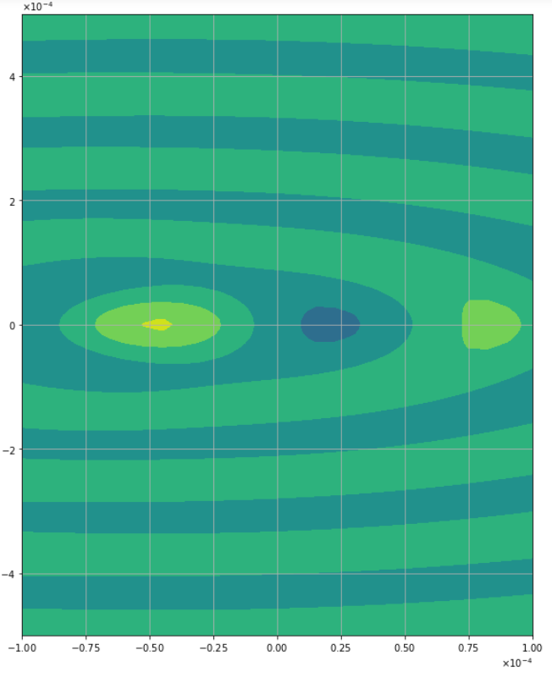
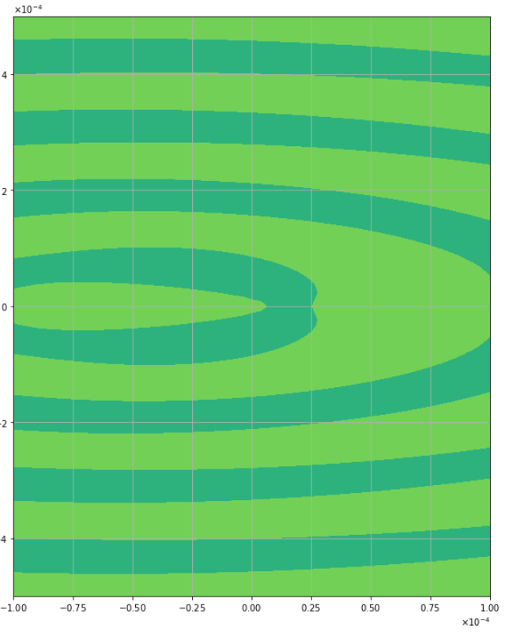
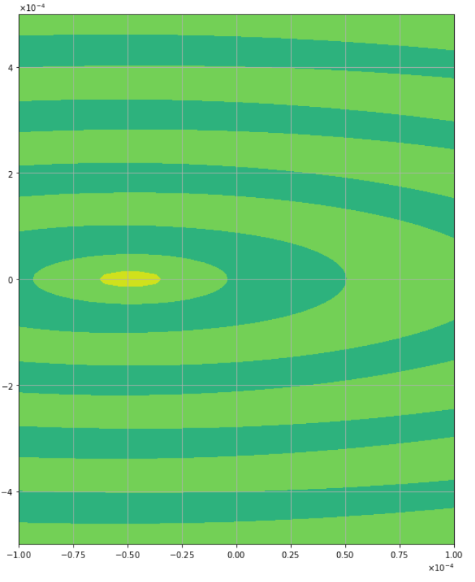
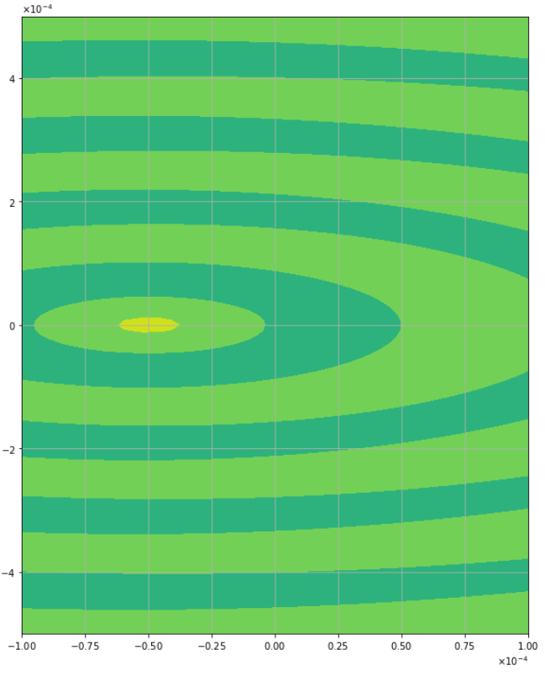
50 micron
K=2
K=4
K=6
K=8

Slide 6
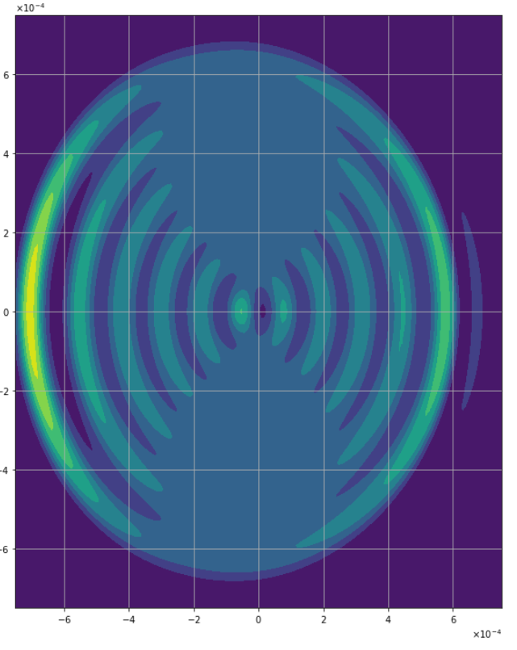
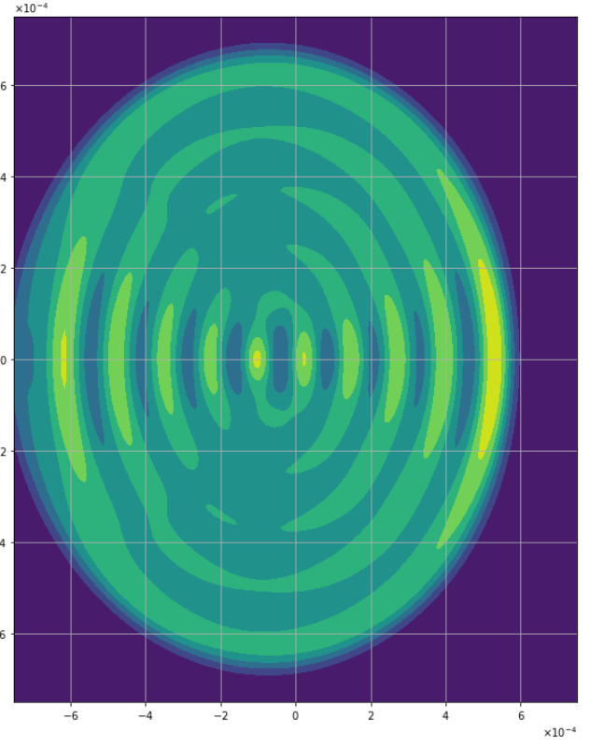
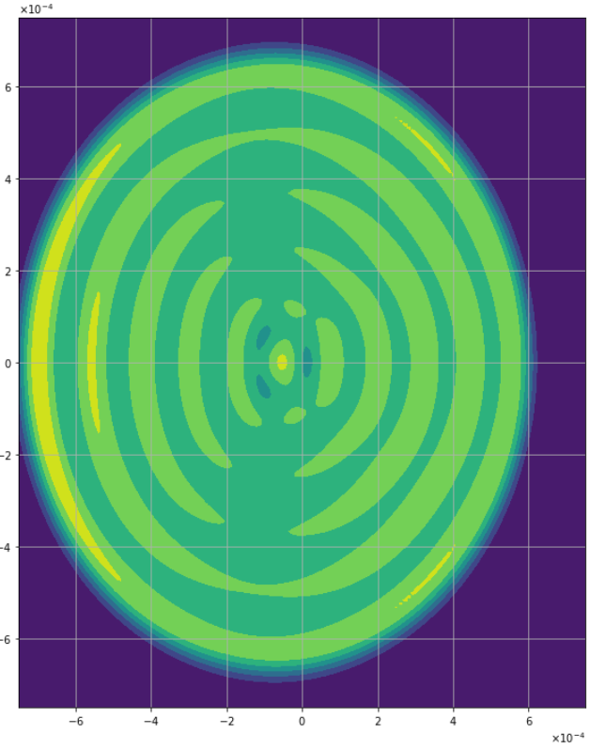
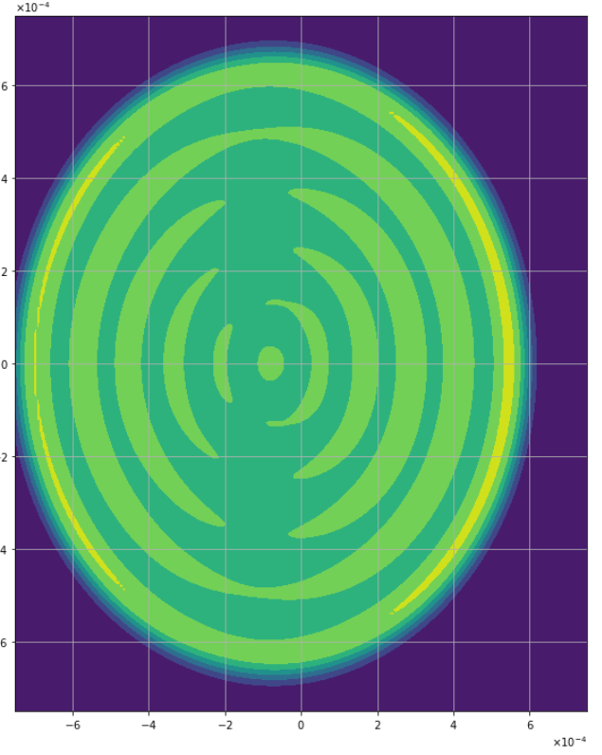
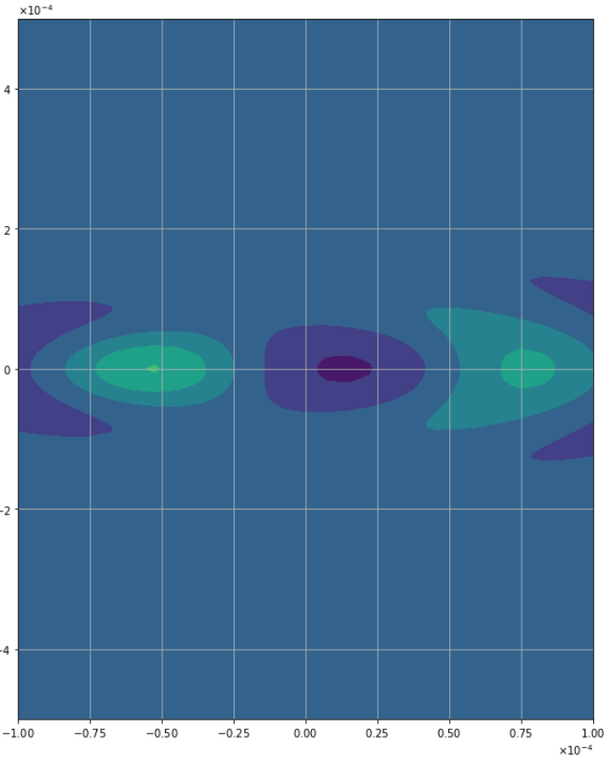
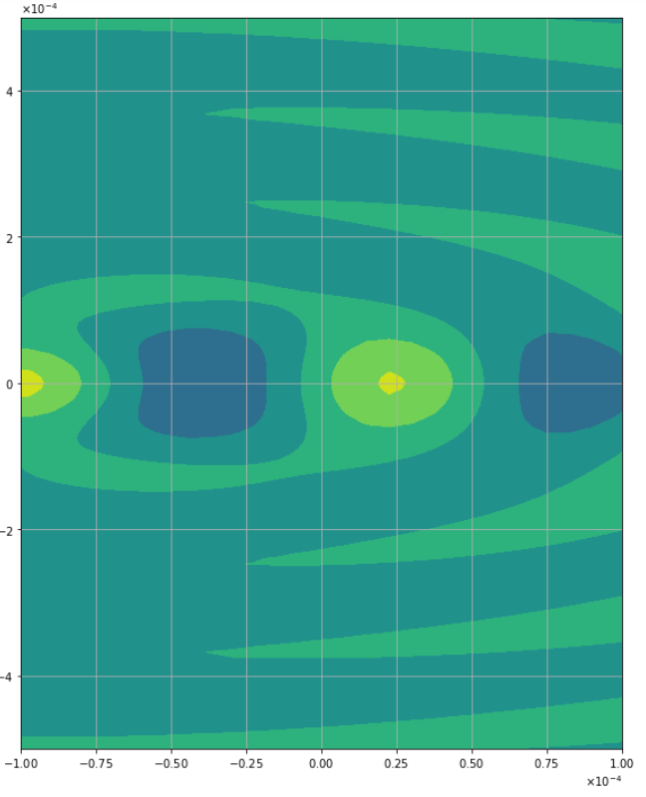
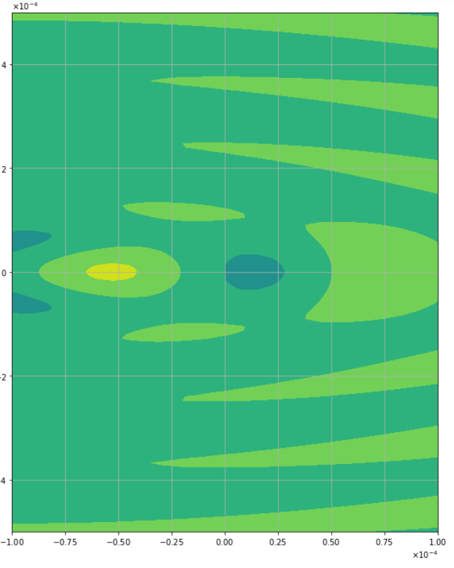
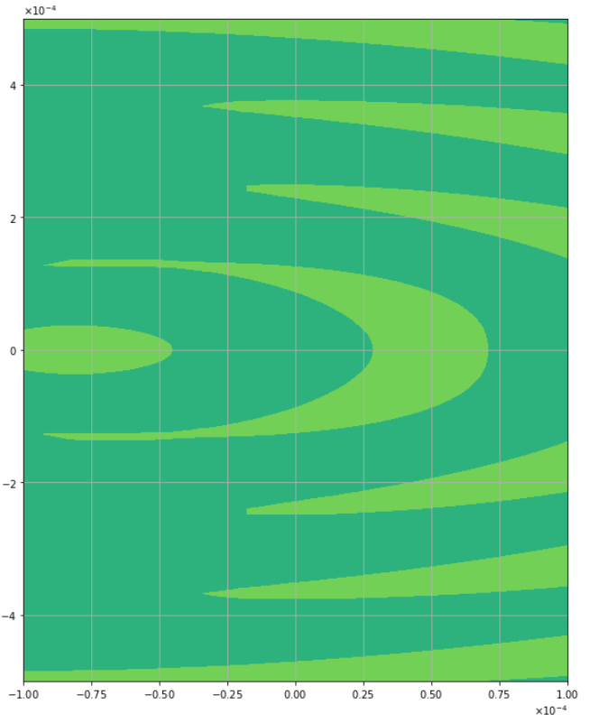
75 micron
K=2
K=4
K=6
K=8

Slide 7
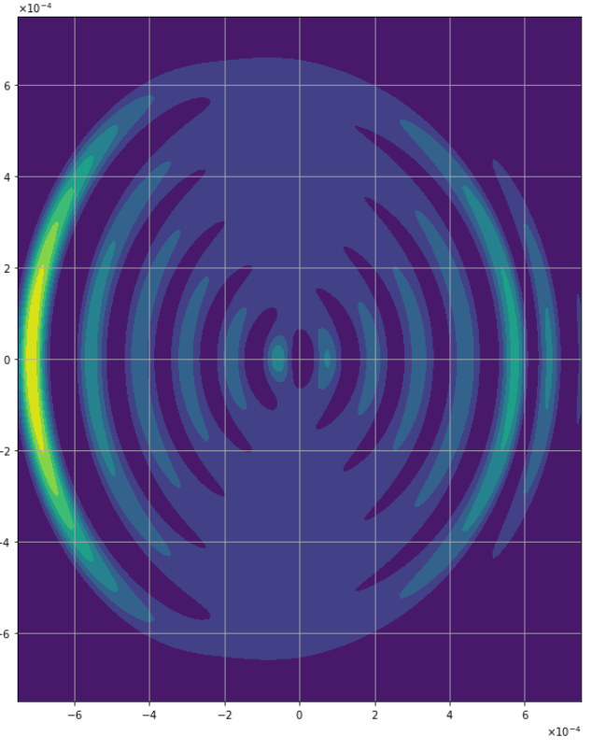
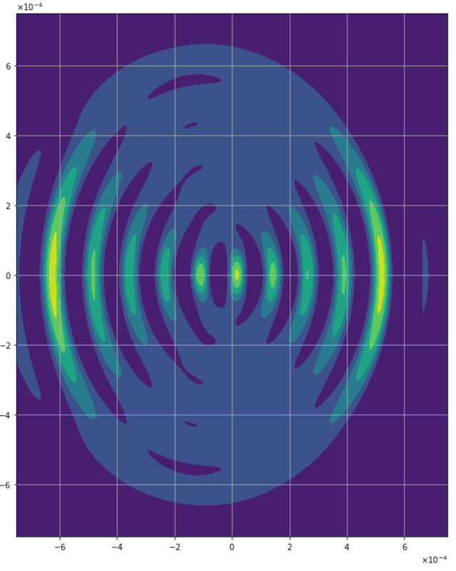
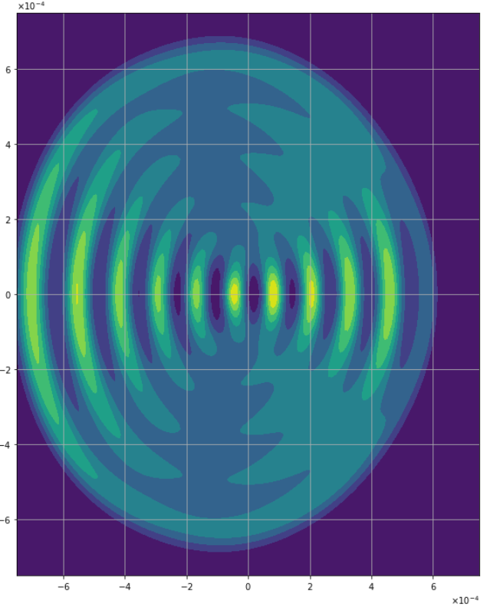
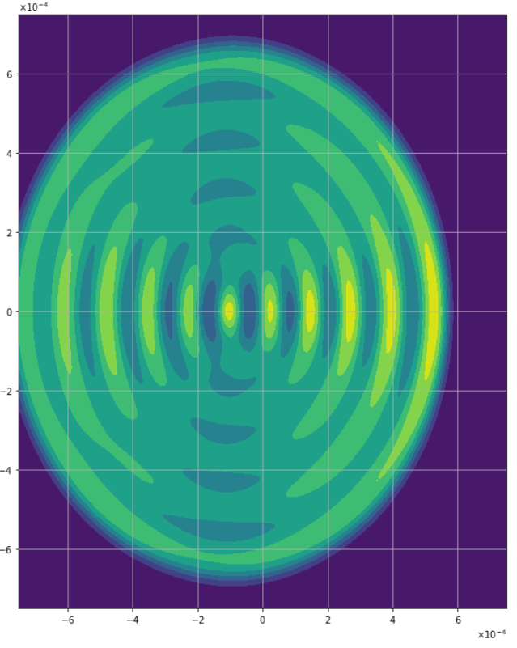
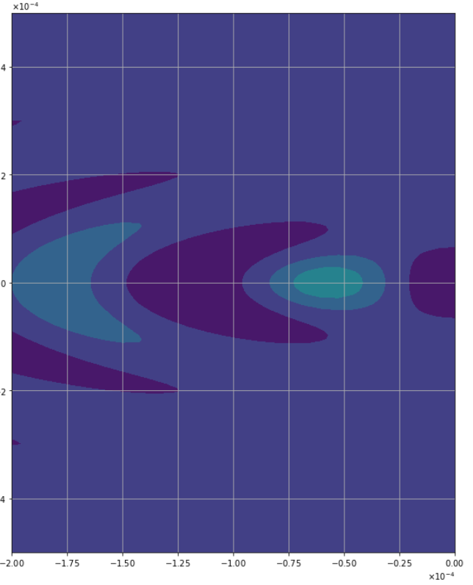
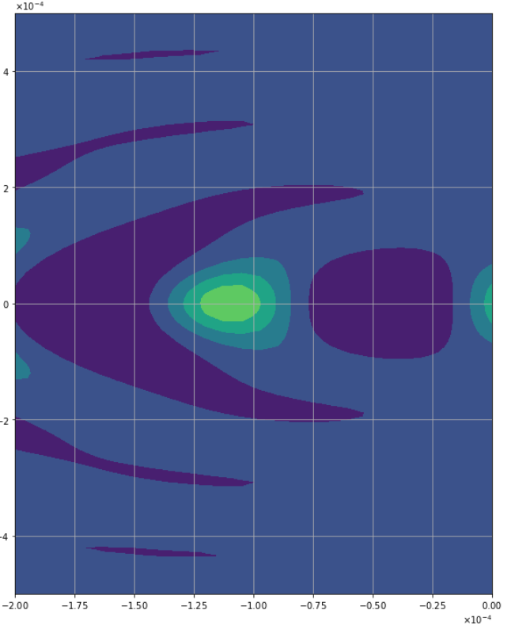
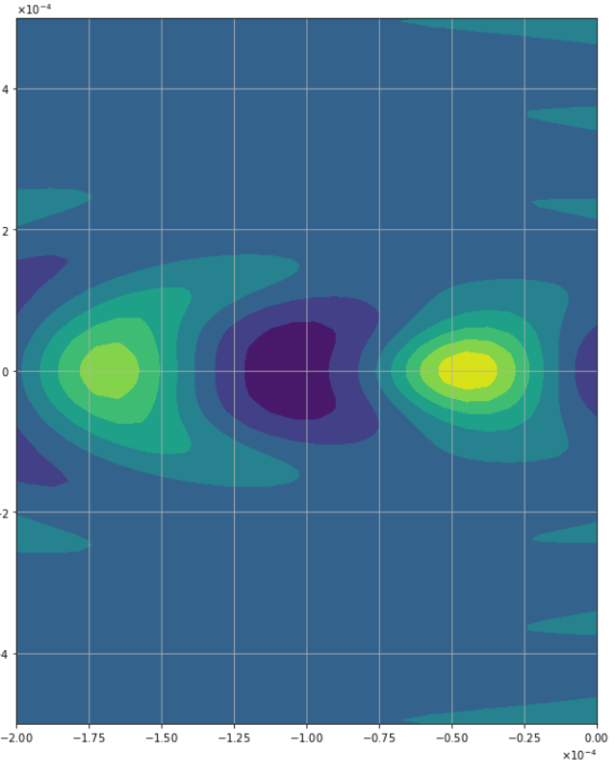
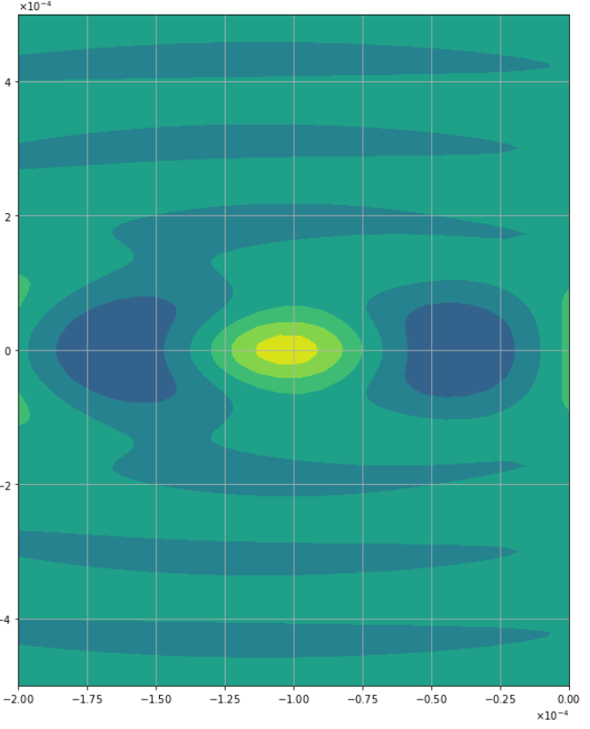
100 micron
K=2
K=4
K=6
K=8

Slide 8
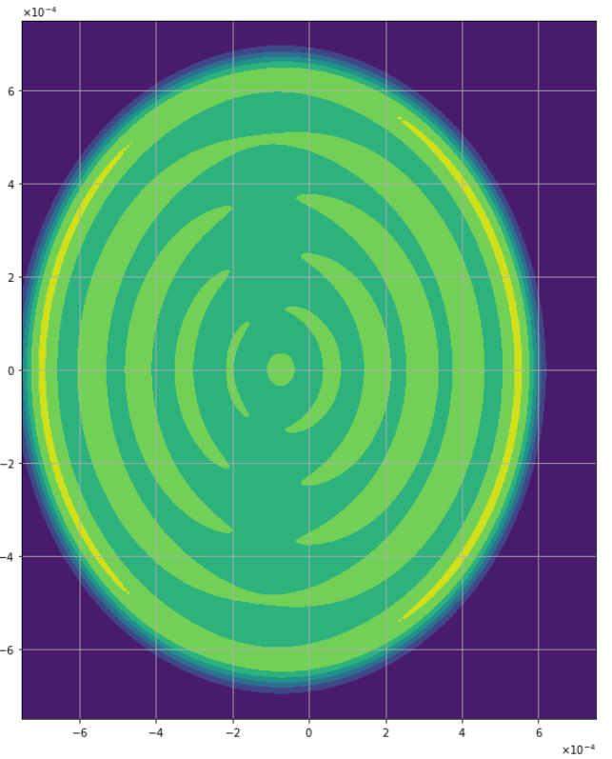
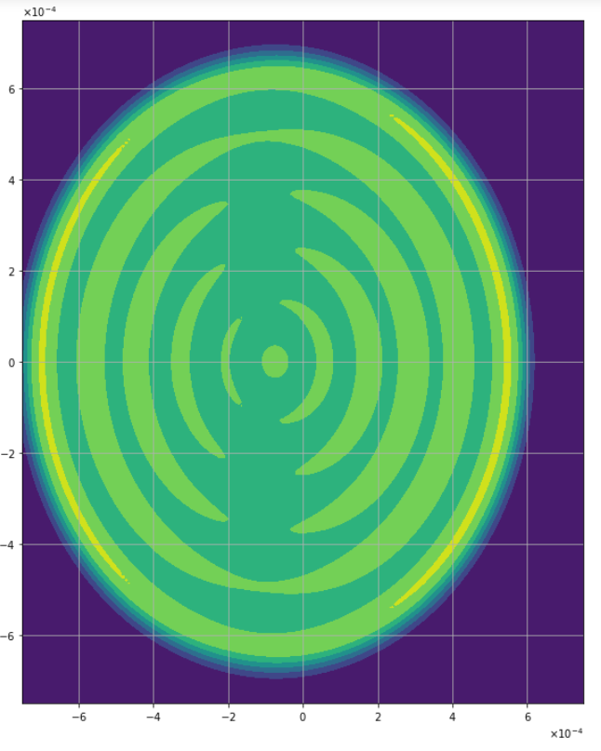
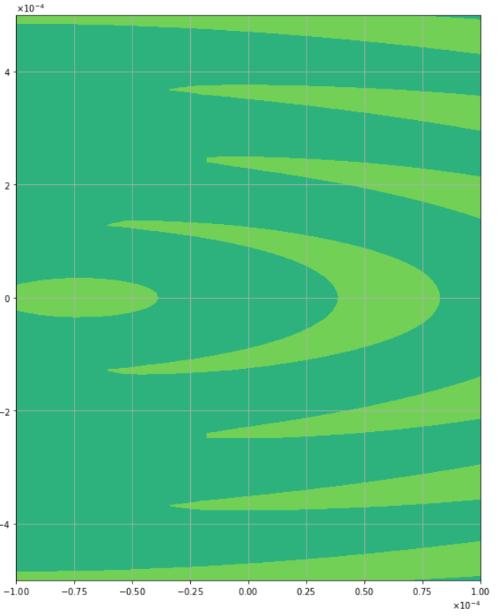
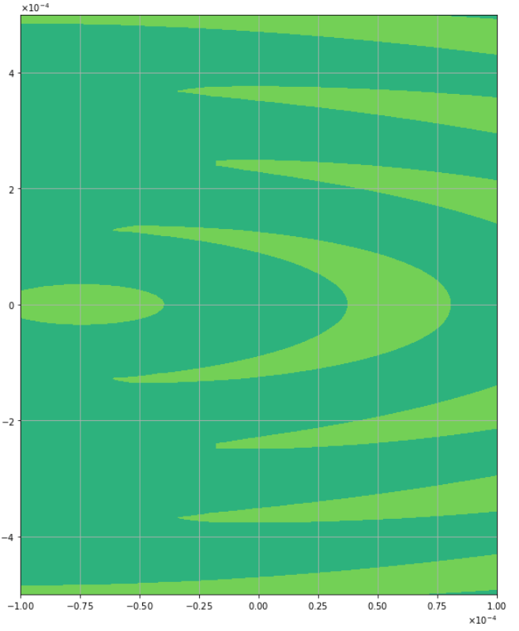
75 micron (revisited)
K=8
K=10
K=12

Slide 9
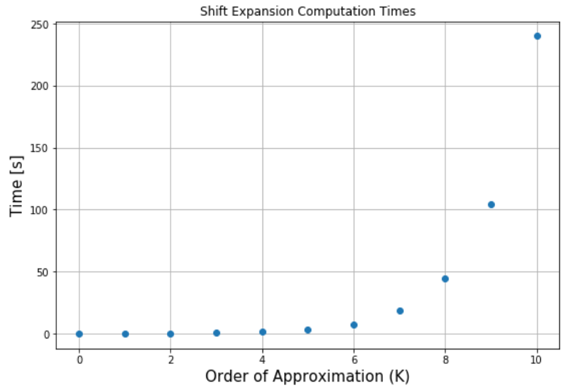
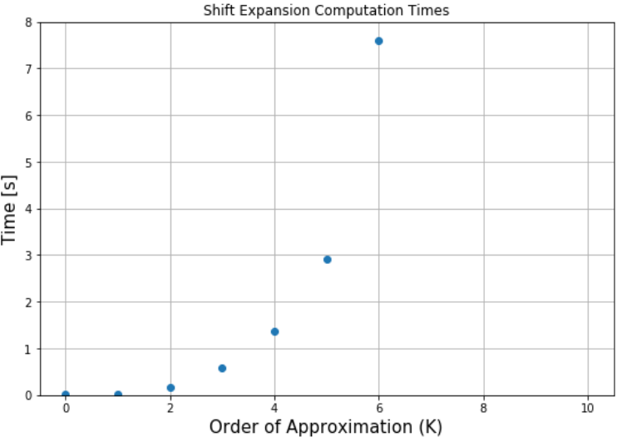
Performing the expansion for updated C_{nm} ( no signal calc. or tilt)
Up to 10th order:
a¹⁰ terms
x¹⁰ terms
Mode order 34 tophat -> order 44 after x transformations
Computation Times
[0.015625, 0.015625, 0.15625, 0.59375, 1.359375, 2.921875, 7.609375, 18.953125, 44.234375, 104.390625, 240.046875]

Slide 10
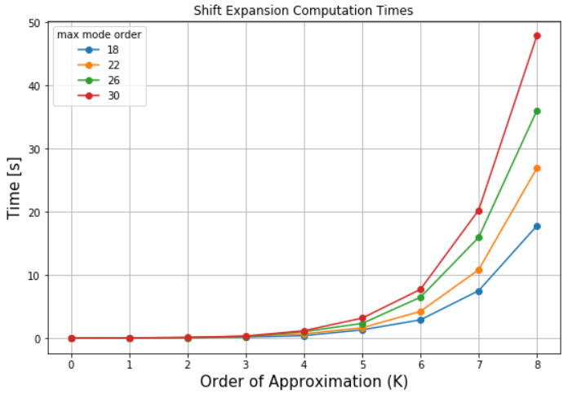
Computation Times: Varying Tophat Max Mode Order
Same scenario as previous slide
Times shown below
Time ~double from mode 18 to 26
~O(n²) …? (34 went fast)

Slide 11

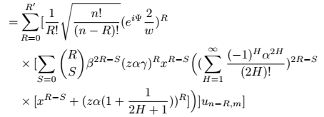
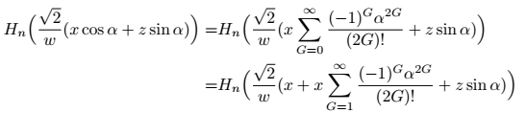
J-th order Tilt Sneak-peek

Slide 12

What’s Next?
Proposal | Time?
More 1st order tilt-shift results | ?
More shift analysis, signals with 1st order tilt, K^{th} order shift | < 1 week
Simplified J^{th} order tilt solution, signals with J^{th} order shift | ~ 1-2 weeks
Full J^{th} order tilt solution | ~ 3-4 weeks

